Slide 1

Operation Analytics & Investigating Metric Spikes
Prepared by : Shivam Singh
Email id: Shivamkumsingh@gmail.com

Slide 2

Contents
Project Description
Approach
Tech-Stack Used
Case Study 1 (Job Data Analysis) & Insights
Case Study 2 (Investigating Metric Spike) & Insights
Result and Conclusion

Slide 3
Project Description
The project is based on two significant case studies that utilizes SQL queries to analyze data:
Operational Analytics – This is when we analyze the job data to measure the operational efficiency. Some of the key metrics: number of jobs reviewed, 7-day rolling average throughput, language distribution, duplicate detection.
Analysis of Metric Spike — Through analysis of user growth, weekly retention, weekly engagement and email interaction patterns, this study investigates fluctuations in user engagement.

Slide 4

Approach
Data Extraction: Using MySQL to extract job data, user engagement events, as well as email interactions.
Data cleaning: Checked for missing values, convert the timestamps to standard, select the records that are useful.
Analysis: Running MySQL to calculate metrics like throughput, retention, engagement.

Slide 5
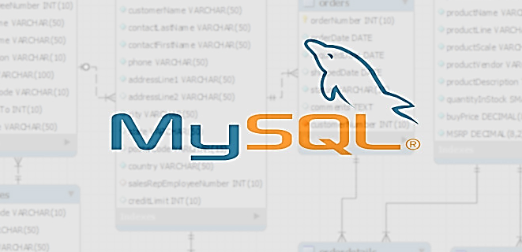


Tech-Stack Used
Database Management:
MySQL Community Server-GPL (Version 8.0.41): Used for creating and managing the database.
MySQL Connector C++ (Version 8.0.41): Used for database connectivity and operations.
MySQL Workbench: Used for designing, generating, and inserting values into the database.
Presentation & Reporting:
Microsoft PowerPoint (PPT): Used for structuring and presenting insights.
Google Drive: Used for storing and sharing reports.

Slide 6
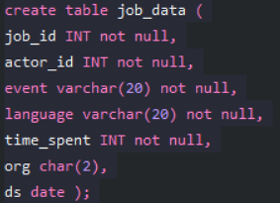
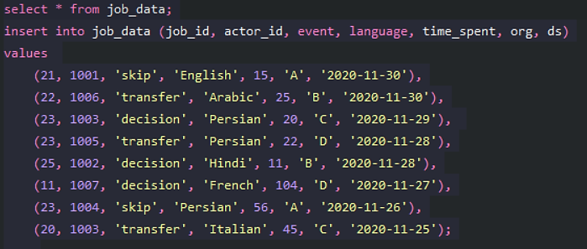
Case Study 1:
Job Data Analysis
Dataset used for Case Study 1: Click here
Create Table name - job_data:
Insert data into table name - job_data:

Slide 7
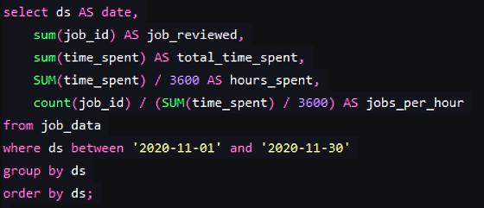

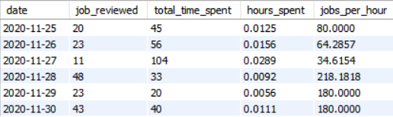
Insights
A. Jobs Reviewed Over Time: Calculate the number of jobs reviewed per hour for each day in November 2020.
The maximum productivity was shown on 28 November (218.18 jobs/hour) and the lowest on 27 November (34.62 jobs/hour).

Slide 8
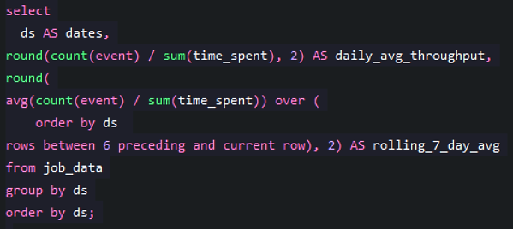
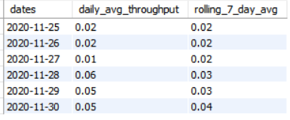
B. Throughput Analysis: Calculate the 7-day rolling average of throughput (number of events per second). Explain whether you prefer using the daily metric or the 7-day rolling average for throughput, and why.
On November 28 (0.06) and on postop 29-30 (0.05), there was a boost in the daily average throughput.
Throughput was pretty low on 27 Nov (0.01), might be complex jobs or job inefficiencies on that day.
Rolling average increased from 0.02 to 0.04 between mid March and the end of the month which suggests that the efficiency of that increase improved towards late in the month.

Slide 9

I would prefer using the 7-day rolling average for throughput, and here’s why:
Daily numbers can be all over the place because of workload changes, weekends, or rare events. A rolling average helps smooth things out, making trends easier to see.
A rolling average shows long-term patterns, making it simpler to spot improvements or declines in productivity.
It reduces the impact of extreme values. If there’s an unusually high or low result on a single day, the rolling average ensures that one outlier doesn’t throw off the whole trend.
For long-term decision-making and monitoring, the 7-day rolling average is preferable.

Slide 10
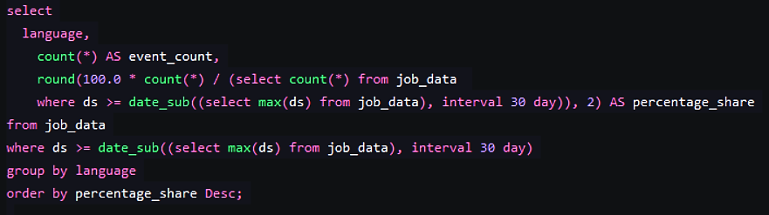
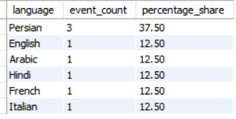
C. Language Share Analysis: Calculate the percentage share of each language in the last 30 days.
Persian is the most used language, accounting for 37.5% of the events, which means that it is significantly more frequent than others in this dataset.
Other languages (English, Arabic, Hindi, French, and Italian) have equal usage, each contributing 12.5% to the total event count.

Slide 11
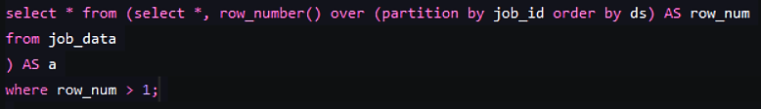
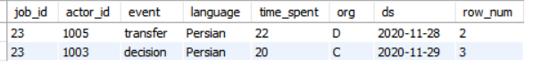
D. Duplicate Rows Detection: Identify duplicate rows in the data.
On the basis of job_id only, below is the duplicates rows.

Slide 12
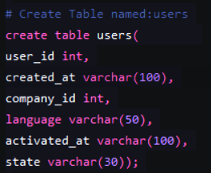
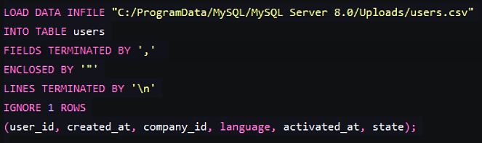
Case Study 2:
Investigating Metric Spike
Dataset used for Case Study 2: Click here
To get the path location of the file to load:
Create Table name - users:
Load the data into table name - users:

Slide 13
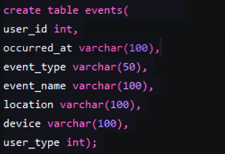
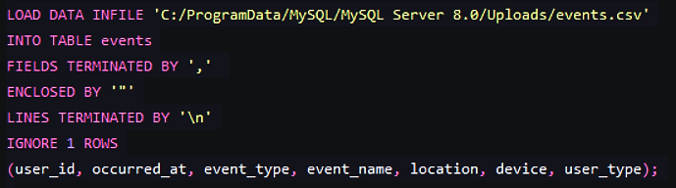
Create Table name - events:
Load the data into table name - events:

Slide 14
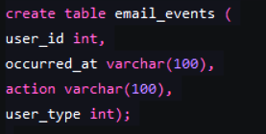
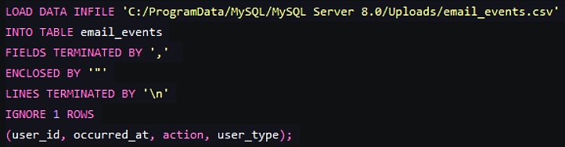
Create Table name – email_events:
Load the data into table name – email_events:

Slide 15
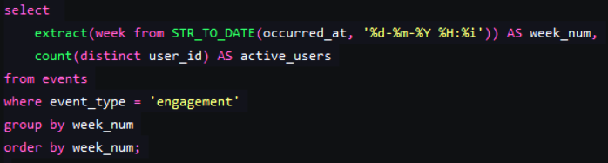
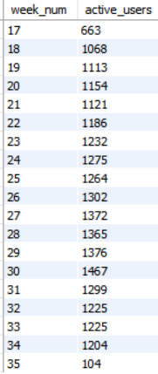

Insights
A. Weekly User Engagement: Measure the activeness of users on a weekly basis.
The number of active users increased consistently from Week 18 (1068 users) to Week 31 (1,299 users).
After Week 31, there is a gradual decline in active users, dropping to 104 users by Week 35.

Slide 16
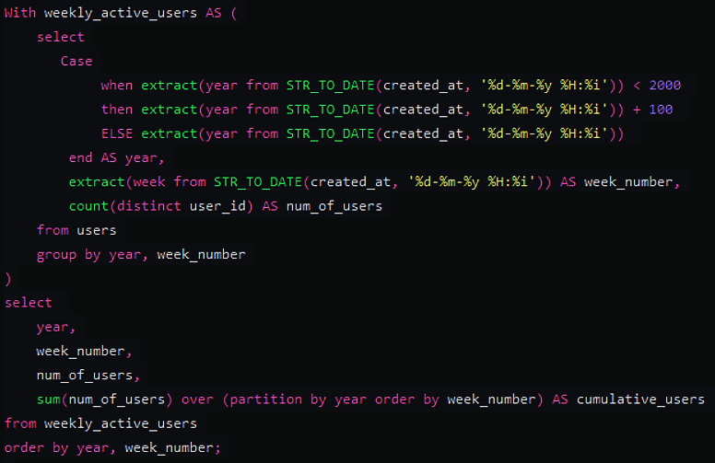
B. User Growth Analysis: Analyze the growth of users over time for a product.
The number of new active users varies each week, but the cumulative user count shows a steady increase. For example, Week 1 begins with 53 users, and by Week 10, the total reaches 404.
Click here for the Output

Slide 17
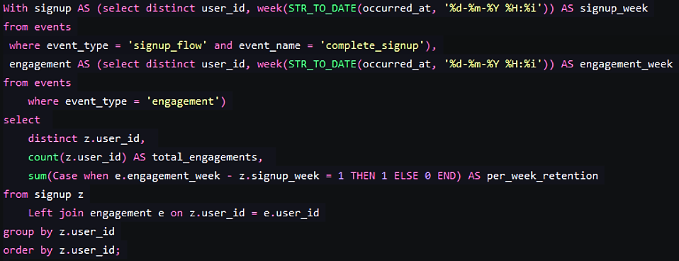
C. Weekly Retention Analysis: Analyze the retention of users on a weekly basis after signing up for a product.
Users who interact precisely a week after registering are tracked by retention. Numerous users (such as 11768, 11770, and 11778) have a weekly retention rate of 0, meaning they did not return within a week of registering.
Strong retention was shown by users like 11775, 11779, 11780, and 11793 who engaged exactly a week after signing up.
A large number of users with low retention indicates that, even though initial engagement happens, maintaining long-term user activity is still difficult.
Click here for the Output

Slide 18
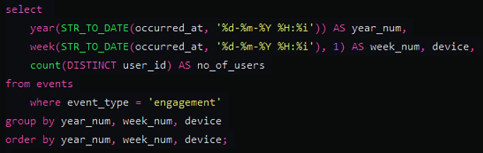
D. Weekly Engagement Per Device: Measure the activeness of users on a weekly basis per device.
Users range in device engagement from laptops, desktops, tablets, and Smartphones. For instance, Dell Inspiron Notebook (49 users) had much more interaction than Amazon Fire Phone (4 users).
Two highly used devices are Dell Inspiron Notebook (49 users) and Asus Chromebook (23 users), which show great participation from laptop users. Additionally highly active are HP Pavilion & Dell Inspiron Desktops (15 and 21 users).
Tablets Based on their 30-user iPad Air and 21-user iPad Mini, tablets are apparently used actively but not as much as laptops.
Smartphones Have Lower Engagement like Amazon Fire Phone (4 users) and HTC One (16 users) show less interaction.
Click here for the Output

Slide 19
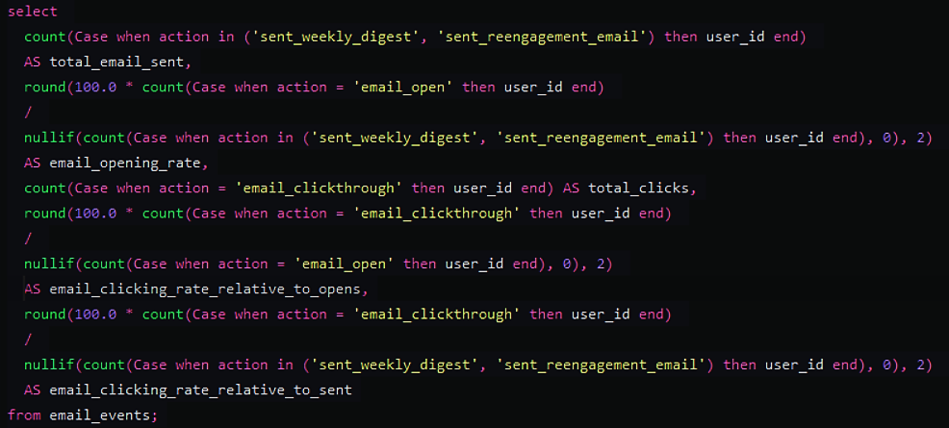
E. Email Engagement Analysis: Analyze how users are engaging with the email service.
The rate of email opens (33.58%) which implies that there is potential for improvement.
High Opened Email Engagement Rate (44.04%), which suggests that the email body contains powerful calls to action and highly relevant content.
The overall click-through rate is 14.79%,although it could be improved.

Slide 20


Result and Conclusion
The 7-day rolling average gave a better picture of throughput trends, indicating higher efficiency at the end of the month. Duplicate detection ensured accuracy in data.
Active users increased steadily through Week 31, after which there was a decline in engagement. Retention analysis identified difficulties in retaining users engaged post-sign-up.
The laptops performed best in engagement, while smartphone performance was least. Email openings (33.58%) were decent, whereas click-through activity (14.79%) can be improved towards effective user engagement.
After studying the project we conclude that operational trends can be monitored via rolling averages, while retention activity and email activity require optimization towards user engagement and productivity.

Slide 21


